Slide 1
SECURING PRIVACY AND PREVENTING SCAMS DURING ONLINE PURCHASES
BY
TEAM VULCAN

Slide 2
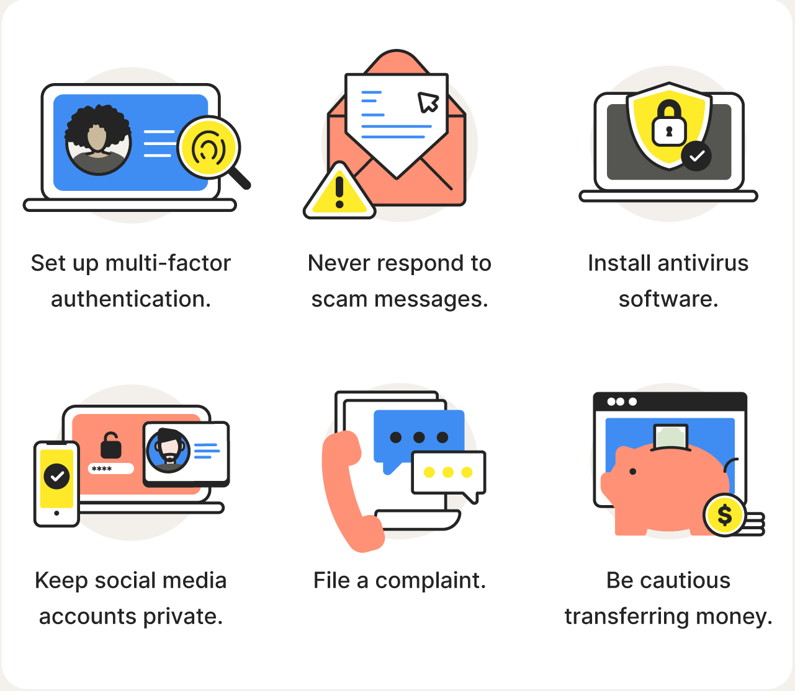
INTRODUCTION
Our aim is to find ways to prevent and reduce online purchase scams and their negative effects on our stakeholders. We also want to find ways to guarantee online privacy for them.
Our Primary Stakeholders are people who spend a considerable time shopping online in the working age group (16 - 60 years).
Our Secondary Stakeholders are Financial Institutions and e-commerce companies.

Slide 3

RESULTS AND FINDINGS : EXPERT EVALUATION
Interface Not User Friendly
They found that the homepage to be cluttered and not easily understandable.
The experts could not navigate the homepage effectively.
This was due to the absence of back buttons or a universal navigation bar.
Lack of User Freedom
In the bank policies section , only the major banks are listed.
Users cannot report numbers from scam calls/messages manually. Only contacts that have been detected as malicious by the LLM will be reported as unsafe in the database.
Based on the Expert Feedback, we made modifications to our paper prototype before
conducting the Think-Aloud Evaluation.

Slide 4
RESULTS AND FINDINGS: THINK-ALOUD EVALUATION
Good Variety of Features
The prototype has different type of features like bank policies, latest information updates, search feature, etc.
The variety helps in increasing the interaction of the users with app and also influences the nature of the interaction.
Skepticism regarding the app's legitimacy
Lack of prior experience with similar applications.
Hesitancy to share their contacts, driven by a lack of familiarity with the app.
Enthusiasm and positive review for Contact Database feature
Enables users to search any phone number and check if it has been reported for suspicious activities.
Proactively detect and prevent scams before they occur

Slide 5
USABILITY STUDY FOR HIGH-FIDELITY PROTOTYPE
TARGET PARTICIPANTS
We will be recruiting 10-12 participants for the Usability Study.
The participants we recruit will comprise of two groups:
Group 1: The stakeholders
Group 2: People who have the basic knowledge to operate the prototype
Group 1 is important to assess whether the prototype fulfils the the target audience’s requirements in an easy and accessible way.
Group 2 is important to assess the whether the prototype is intuitive or not. Using the prototype should not require specialized knowledge from the users.

Slide 6
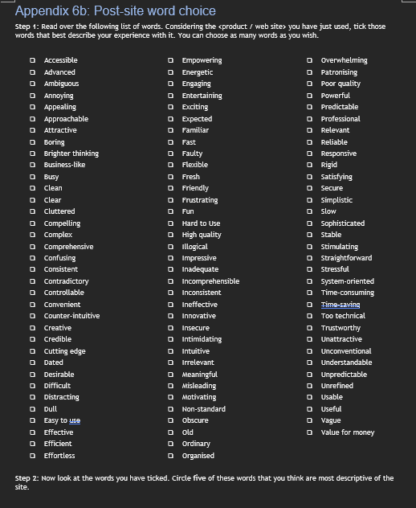
USABILITY STUDY FOR HIGH-FIDELITY PROTOTYPE
INSTRUMENTS
Study Protocol and Consent Form
System Usability Scale (SUS)
Likert-scale questions
Tasks for the participants to perform while evaluating the High- Fidelity prototype
Feedback Questionnaire (Word-choice questionnaire)
Open ended feedback surveys
Example of Word Choice Questionnaire

Slide 7
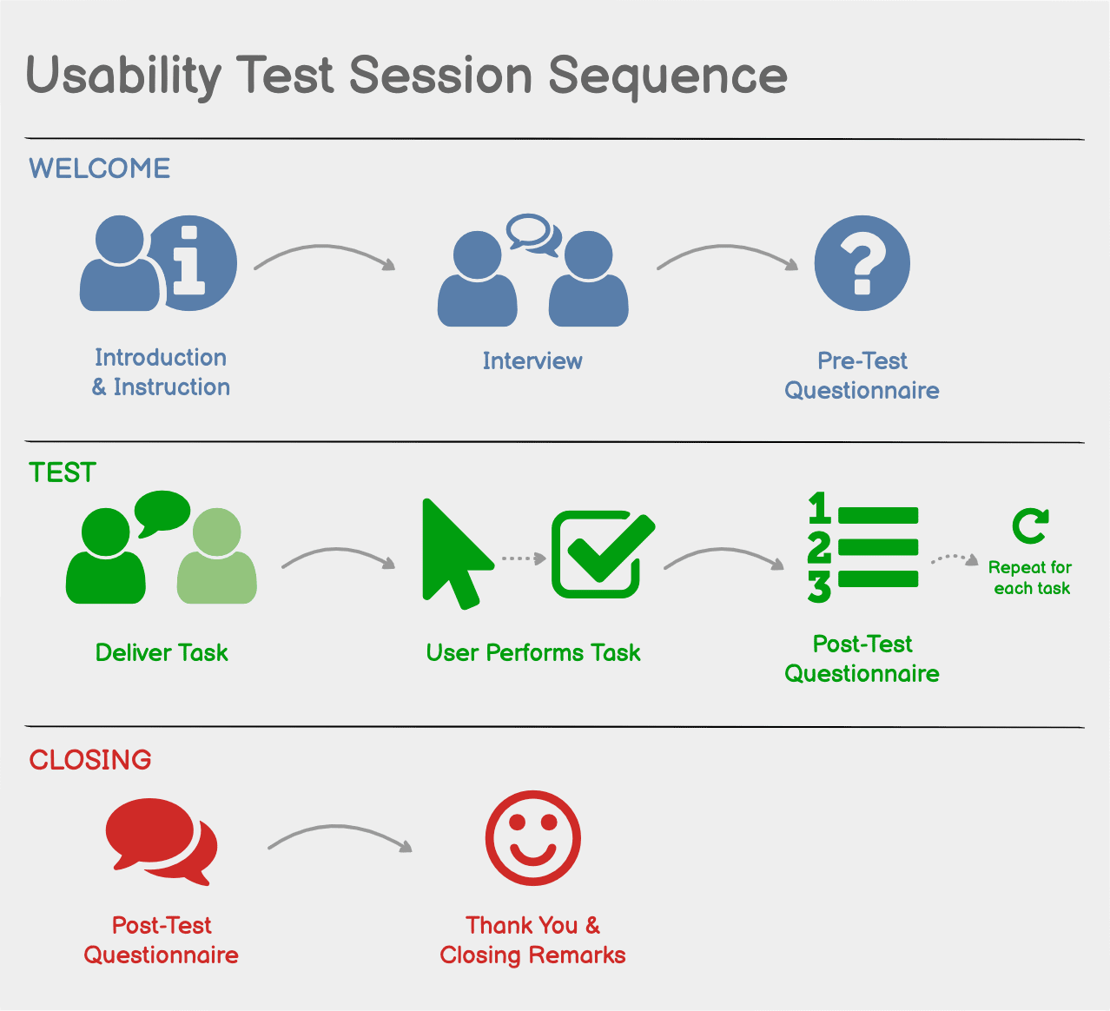
USABILITY STUDY FOR HIGH-FIDELITY PROTOTYPE
PROTOCOL
We will be performing two rounds of testing; with 6 participants per round.
For each round, there will be :
four participants will be from Group 1
two from Group 2 .
Based on the response from the participants in the initial round of usability testing, we will improve on the design and perform another round of usability testing.
The interactions of all users with the app will be screen captured for final evaluation and iteration on the prototype.

Slide 8
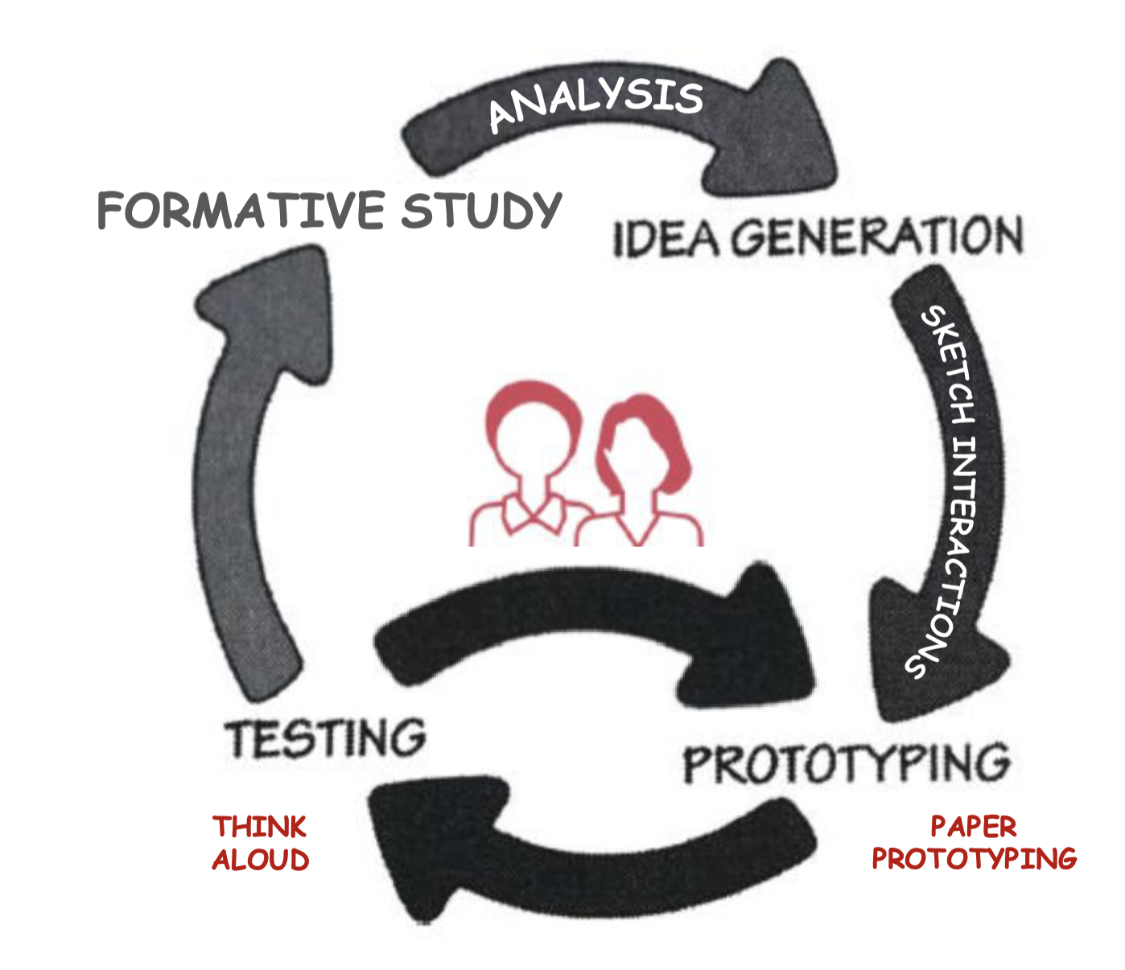
NEXT STEPS
Revise and improve our Job Stories and Functional Requirements from A1.
Developing the High-Fidelity Prototype
Prototype to be developed using Figma
Incorporating the feedback from our A2 Findings into the prototype.
Recruit participants for the Usability Testing of the High-fidelity Prototype
Conduct the Usability Testing in Two Rounds

Slide 9

QUESTIONS
In order to ensure a user’s privacy is respected, they need to allow the app to access their calls and messages. However, there are instances where users don’t really pay attention to these permissions. Apart from app permissions, how can a user’s privacy be upheld while using the app?
We are taking into account communication between users on our app. Should we implement a communication feature (like a discussion forum) to allow users to discuss and share scam-related information?

